Slide 1

PROJECT OVERVIEW [SKIP IF FAMILIAR]
EASY
ADVANCED

Slide 2

PROJECT CARD
GOAL:
The objective of this case study is to predict the health insurance cost incurred by Individuals based on their age, gender, BMI, number of children, smoking habit and geo-location.
TOOL:
AWS SageMaker Autopilot
PRACTICAL REAL-WORLD APPLICATION:
This project can be effectively used by insurance companies to predict healthcare insurance cost, increase revenues and reduce costs.
DATA:
INPUTS:
age, gender, BMI, number of children, smoking habit and geo-location
OUTPUT:
Insurance Charges
Image source: https://www.publicdomainpictures.net/en/view-image.php?image=279909&picture=medical-insurance

Slide 3
DATA OVERVIEW
The available features are:
sex: insurance contractor gender
bmi: Body mass index (ideally 18.5 to 24.9)
children: Number of children covered by health insurance / Number of dependents
smoker: Smoking
region: the beneficiary's residential area in the US, northeast, southeast, southwest, northwest.
Target (output):
charges: Individual medical costs billed by health insurance
Data Source: https://www.kaggle.com/mirichoi0218/insurance

Slide 4
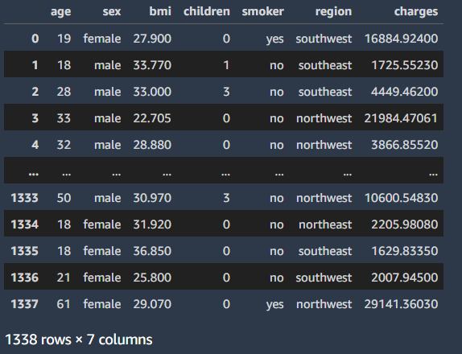
DATA OVERVIEW
TARGET COLUMN

Slide 5
AMAZON SAGEMAKER AUTOPILOT
EASY
ADVANCED

Slide 6
AMAZON SAGEMAKER
BUILD
SageMaker offers data labeling service
TRAIN
Manage environments for training
DEPLOY
Prebuilt available notebooks with state-of-the-art algorithms on AWS marketplace
Hyperparameters optimization for model tuning
Train models using EC2 instances (on-demand and spot)
Easily deploy and scale models
Autoscaling with 75% savings
Amazon SageMaker is a fully-managed machine learning workflow platform that provides services on data labeling, model building, training, tuning and deployment.
SageMaker allows data scientists and developers to build scalable AI/ML models easily and efficiently.
Models could be deployed in production at a much faster rate and with a fraction of the cost.
Let’s explore SageMaker: https://aws.amazon.com/sagemaker/#

Slide 7


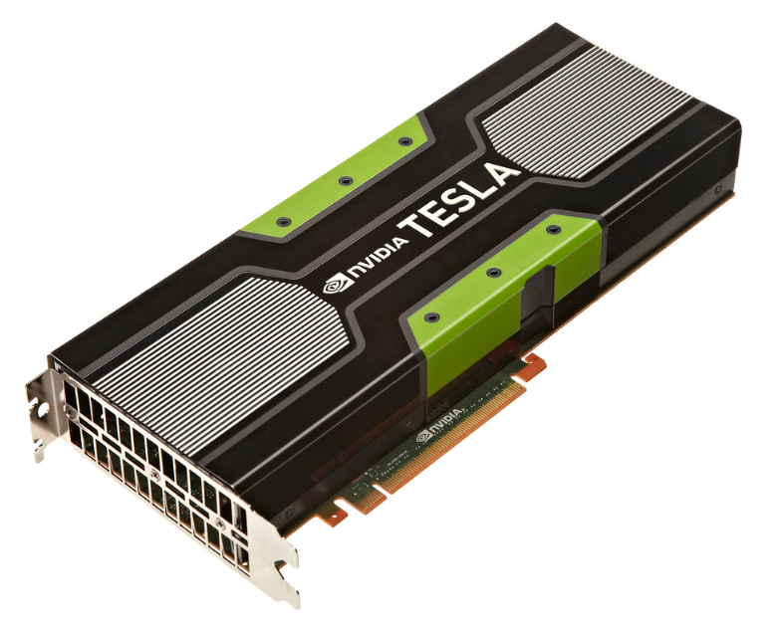
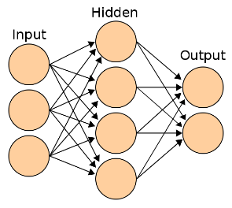
AMAZON SAGEMAKER MODEL TRAINING AND DEPLOYMENT OVERVIEW
https://commons.wikimedia.org/wiki/File:Artificial_neural_network.svg
https://commons.wikimedia.org/wiki/File:AWS_Simple_Icons_Storage_Amazon_S3.svg
https://docs.aws.amazon.com/sagemaker/latest/dg/how-it-works-training.html
https://www.flickr.com/photos/gbpublic/8178512552
Source: https://docs.aws.amazon.com/sagemaker/latest/dg/how-it-works-training.html
CLIENT
END POINT
Inference code image
MODEL DEPLYMENT/HOSTING
On ML Compute instances
S3 BUCKET
MODEL ARTIFACTS
Training code image
MODEL TRAINING
On ML Compute instances
S3 BUCKET
TRAINING BUCKET
EC2 CONTAINER REGISTERY
AMAZON SAGEMAKER

Slide 8
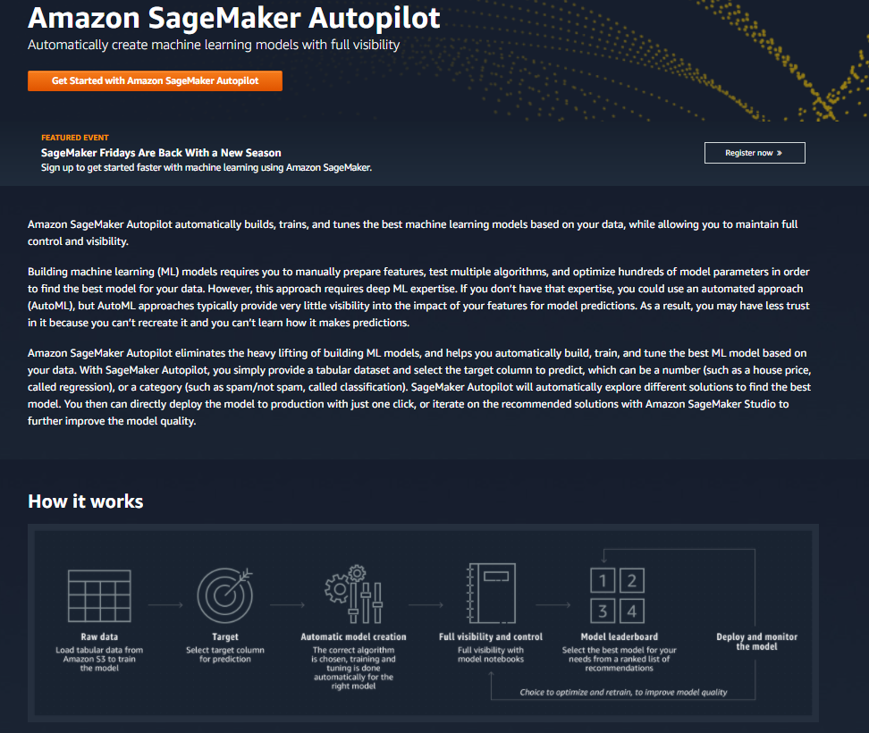
AMAZON SAGEMAKER AUTOPILOT 101
Check this out: https://aws.amazon.com/sagemaker/autopilot/

Slide 9
AMAZON SAGEMAKER AUTOPILOT DEMO
EASY
ADVANCED

Slide 10
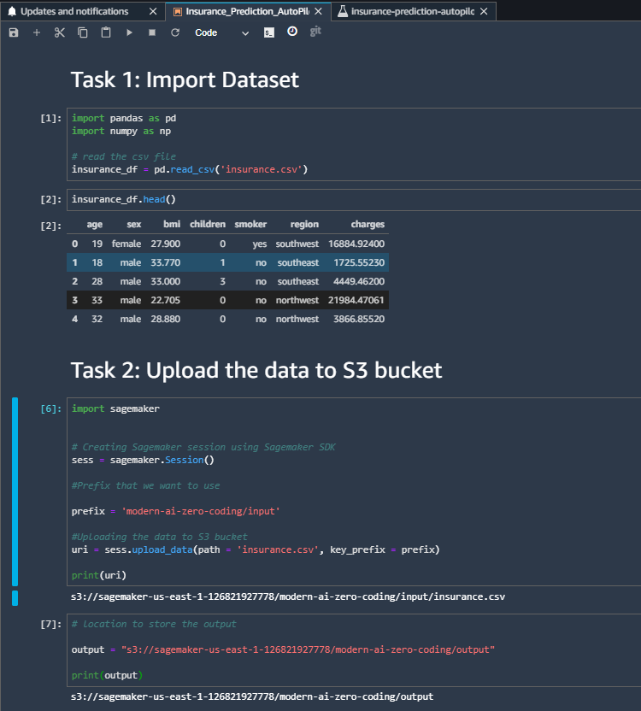
AMAZON SAGEMAKER AUTOPILOT
RUN THIS SCRIPT

Slide 11
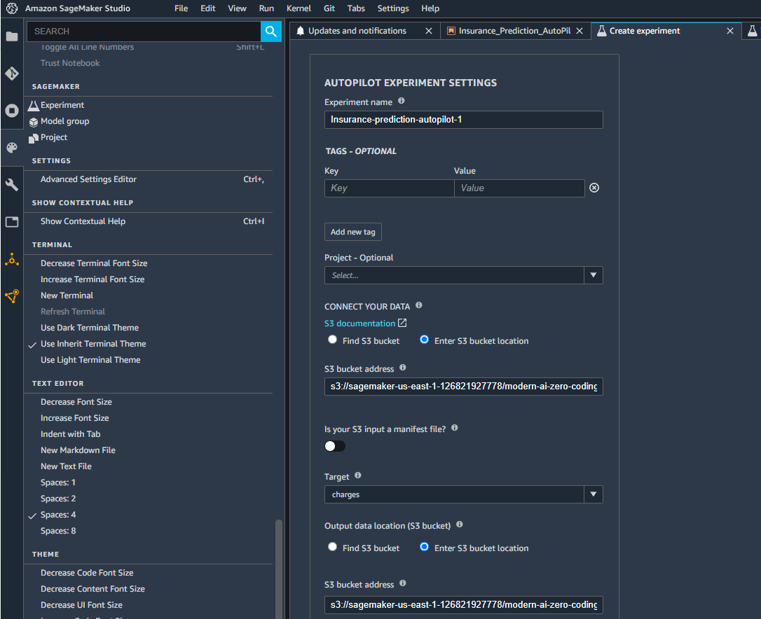
AMAZON SAGEMAKER AUTOPILOT
Check this out: https://aws.amazon.com/sagemaker/autopilot/
1. CLICK ON EXPERIMENT
2. PROVIDE A NAME FOR THE EXPERIMENT

Slide 12
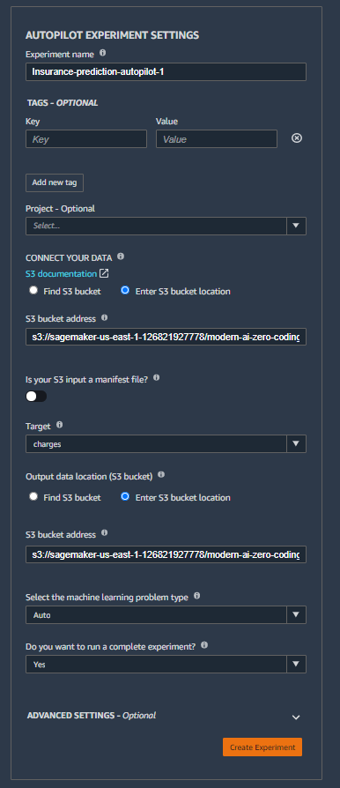
AMAZON SAGEMAKER AUTOPILOT
SELECT ”ENTER S3 BUCKET LOCATION”
PROVIDE THE LOCATION OF TRAIN DATA IN S3 (CAN BE FOUND IN .IPYNB NOTEBOOK)
PROVIDE THE COLUMN NAME OF TARGET VARIABLE
SELECT “ENTER S3 BUCKET LOCATION”
PROVIDE THE PATH TO STORE THE OUTPUT IN S3 (CAN BE FOUND IN .IPYNB NOTEBOOK)
CLICK CREATE EXPERIMENT

Slide 13
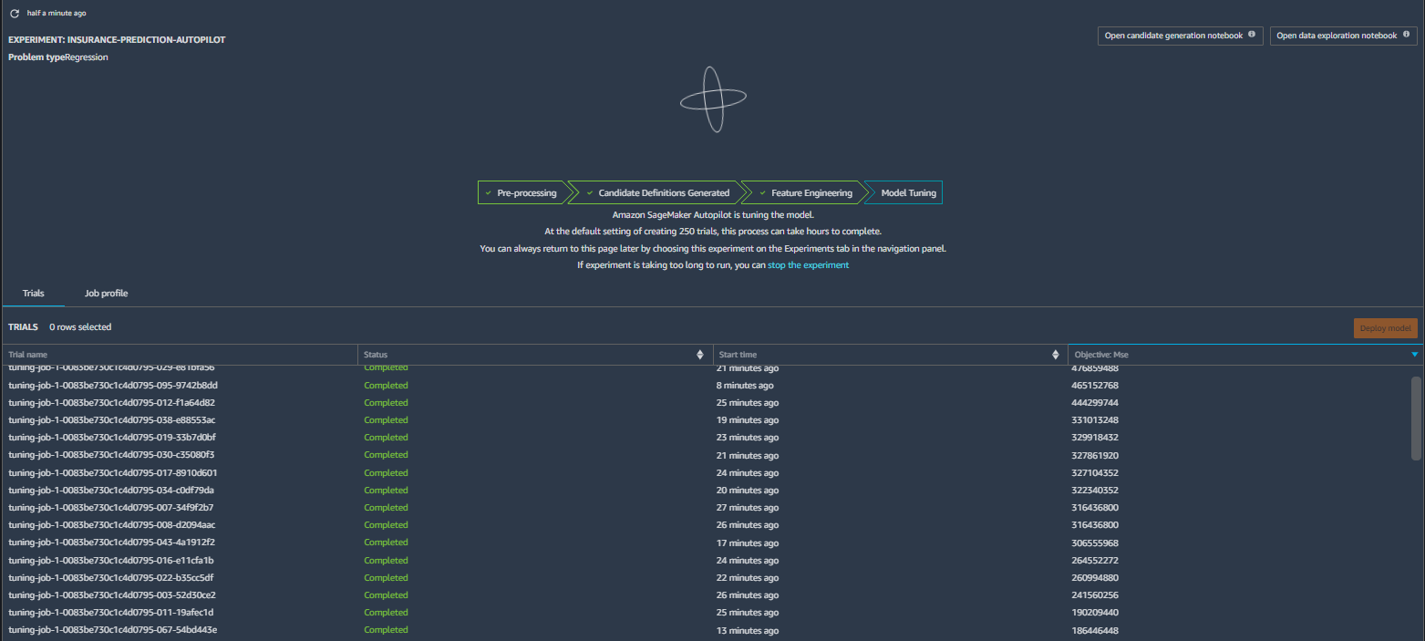
AMAZON SAGEMAKER AUTOPILOT
AFTER CREATING EXPERIMENT, YOU SHOULD SEE SOMETHING LIKE THIS.
IT WOULD TAKE AROUND 2 HOURS TO COMPLETE. THIS IS BECAUSE BY-DEFAULT IT WOULD RUN 250 TUNING JOBS TO FIGURE-OUT THE BEST HYPER-PARAMETER

Slide 14
AMAZON SAGEMAKER AUTOPILOT
Once first 2 steps are completed, you can view candidate generation notebook and data exploration notebook.
CLICK ON THESE TO OPEN RESPECTIVE NOTEBOOKS.
NOTE: GENERATED NOTEBOOKS FROM OUR EXPERIMENT ARE PROVIDED FOR REFERENCE.

Slide 15
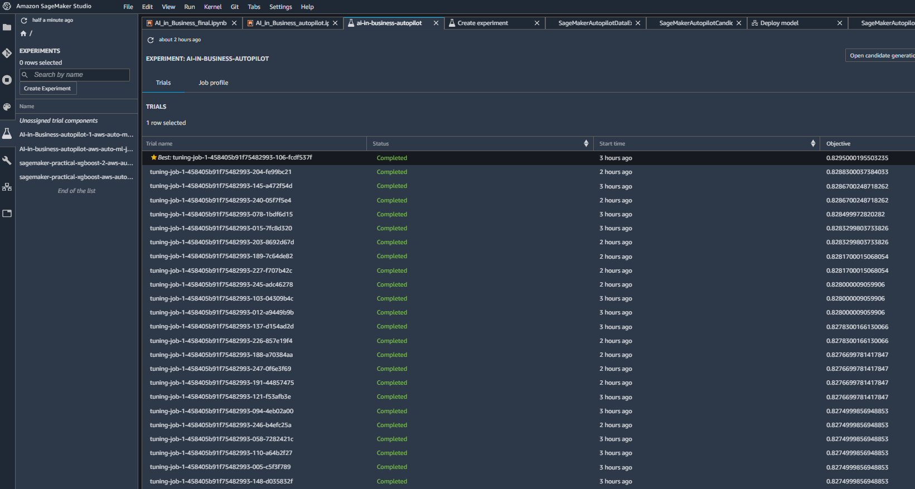
AMAZON SAGEMAKER AUTOPILOT
ONCE THE JOB IS COMPLETED, YOU CAN SELECT THE BEST MODEL AND THEN CLICK ON DEPLOY MODEL TO DEPLOY.

Slide 16
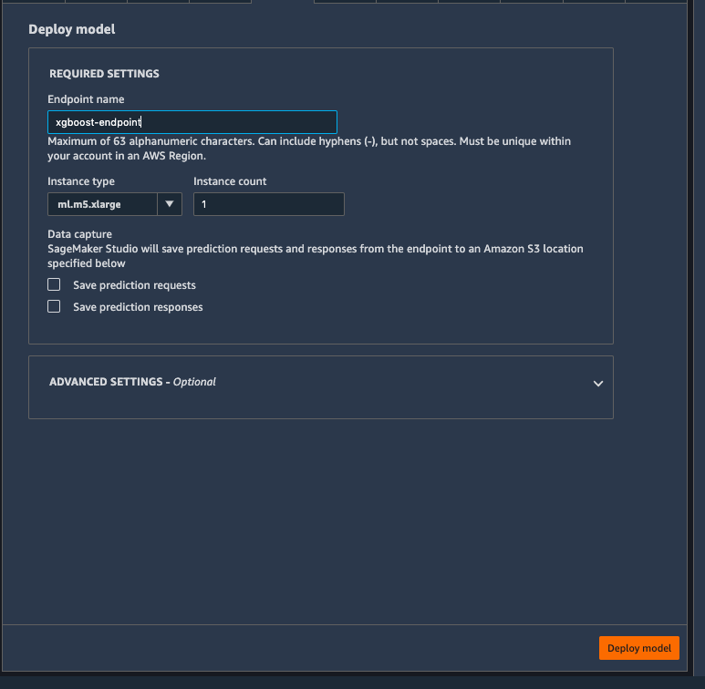
AMAZON SAGEMAKER AUTOPILOT
PROVIDE THE NAME FOR END-POINT
SELECT THE INSTANCE TYPE AND THE NUMBER OF INSTANCE
CLICK TO DEPLOY THE MODEL

Slide 17
DELETE ENDPOINT [IMPORTANT]
EASY
ADVANCED

Slide 18
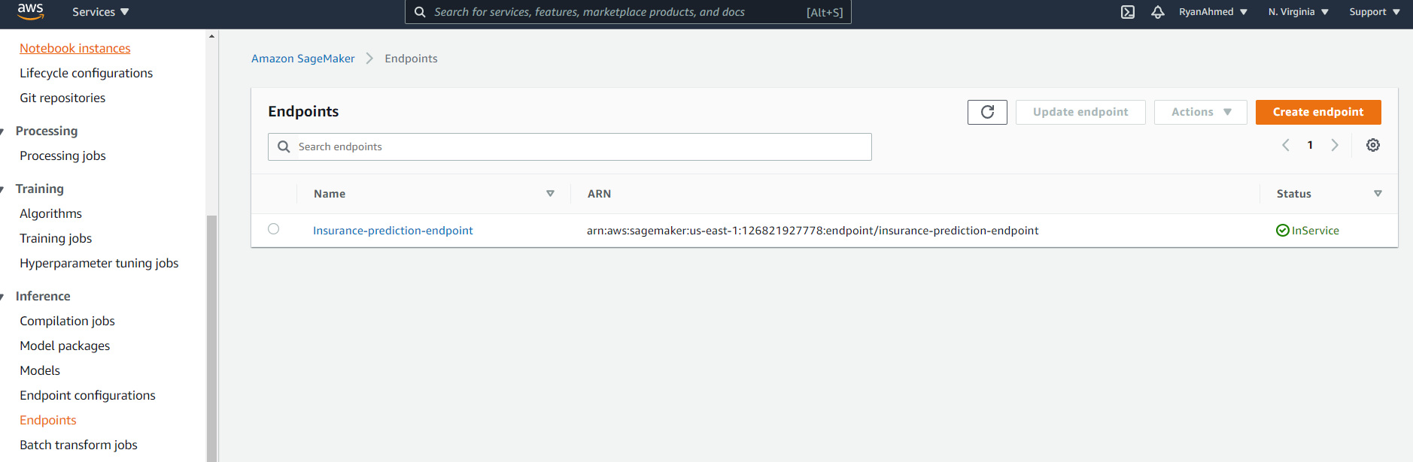
DELETE ENDPOINT [IMPORTANT]
SELECT ENDPOINT
CLICK ACTION AND DELETE THE ENDPOINT

Slide 19
FINAL END-OF-DAY CAPSTONE PROJECT
EASY
ADVANCED

Slide 20
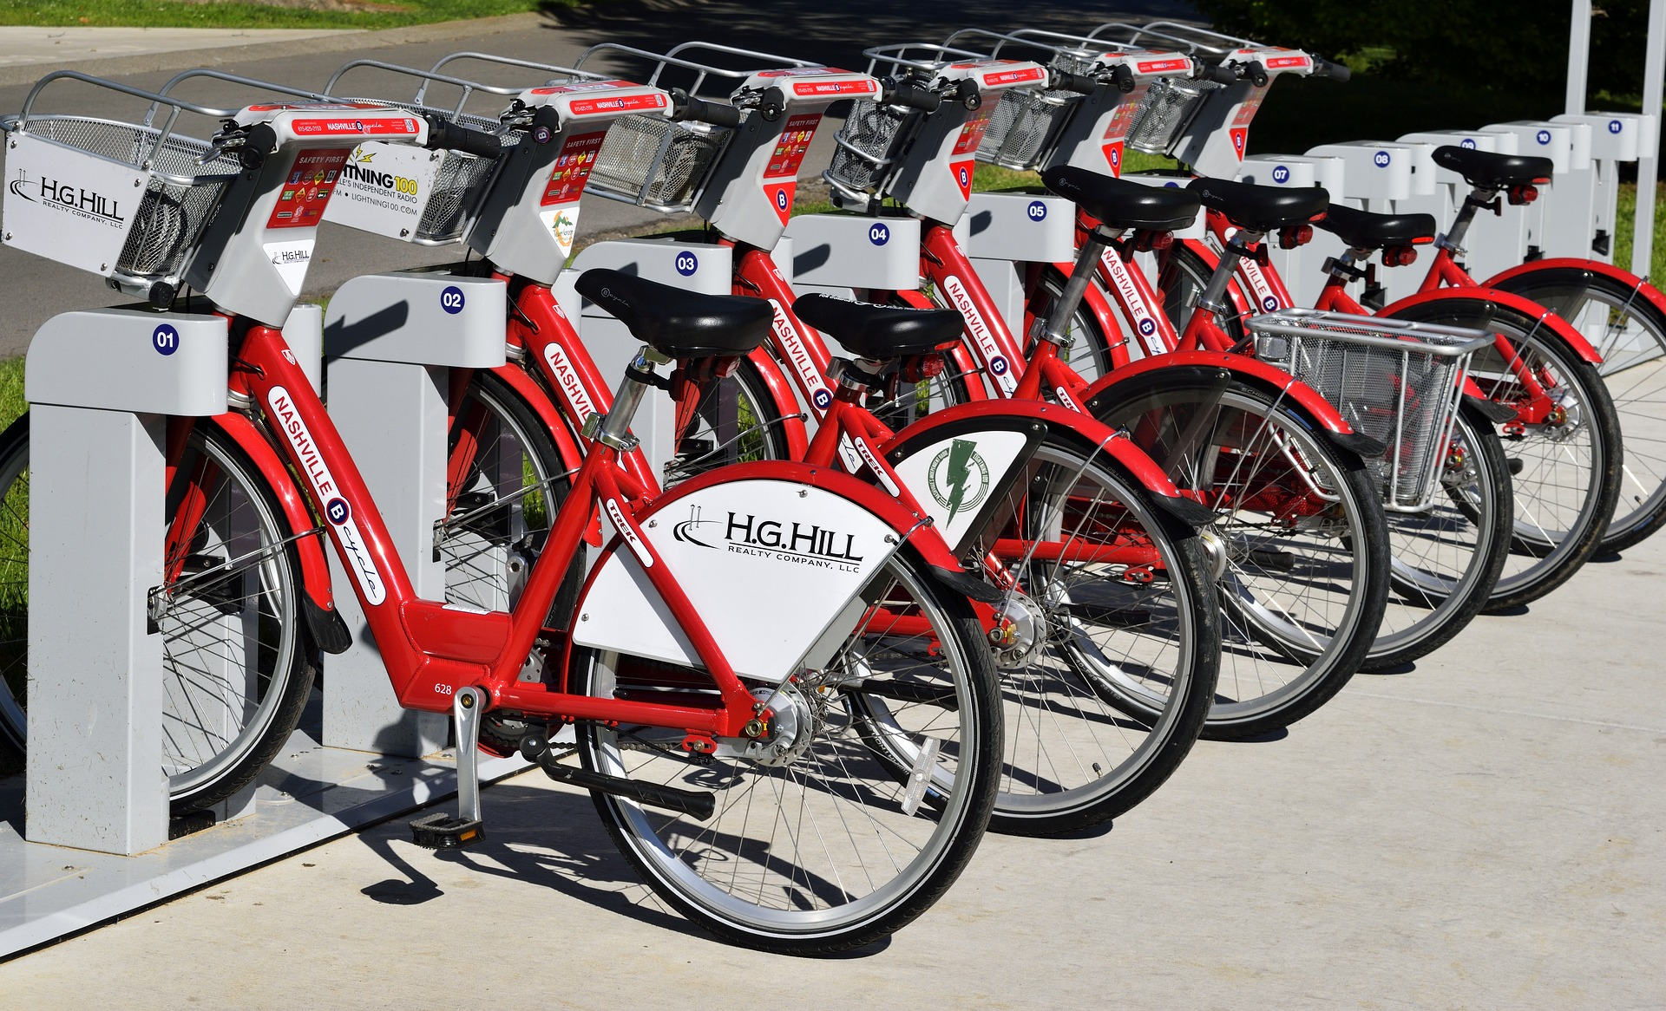
PROJECT OVERVIEW
The goal of this project is to use AWS SageMaker Autopilot to build, train, test machine learning models to predict bike rental usage using inputs such as temperature, humidity, wind speed..etc.
This project can be effectively used by bike rental shops to predict demand and expected future sales and understand key factors that contribute to generating revenue.
Image Source: https://pixabay.com/photos/bike-rental-bikes-rent-pay-2284380/
Dataset Source: Hadi Fanaee-T, Laboratory of Artificial Intelligence and Decision Support (LIAAD), University of Porto INESC Porto, Campus da FEUP Rua Dr. Roberto Frias, 378 4200 - 465 Porto, Portugal
Image Source: https://www.flickr.com/photos/pasa/6757993805
Dataset Source: https://www.kaggle.com/ljanjughazyan/cars1

Slide 21
MODEL OVERVIEW
TEMPERATURE
WEATHER
MACHINE LEARNING REGRESSION MODEL USING SAGEMAKER AUTOPILOT
WINDSPEED
SEASON
BIKE USAGE COUNT (TOTAL)
MONTH
Photo Credit: https://commons.wikimedia.org/wiki/File:Neural_network.svg

Slide 22
PROJECT TASKS
Please complete the following:
Load the “bike_sharing_daily.csv” dataset
Train a machine learning models using AWS SageMaker Autopilot
Assess trained models' performance
Explore the candidate notebooks
Deploy the best model as an endpoint

